Slide 1


FirstNet Consultation Prep Pack
FirstNet Basics
About Consultation
This package contains information that will be helpful in preparing for the FirstNet consultation meeting to occur
July 29th, 2014
The First 3 Sections are geared to all participants
The Next Two Sections are more Technical
The Last Section is Policy and Finance
Need for FirstNet
LTE Basics
Coverage Work
PPP Possibilities

Slide 2




Maryland is the FIRST State to have our Initial Consultation
STATE
Learning experience
Chance to shape the Future
Be patient and provide suggestions
No one knows everything
Ray Lehr – MD
“SPOC”
Single Point of Contact

Slide 3
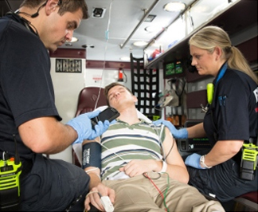
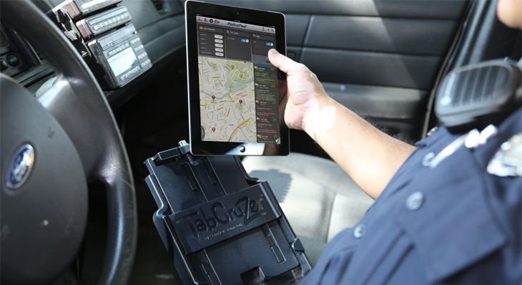
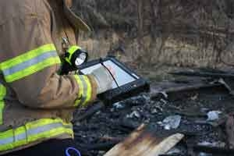
FirstNet Basics
Mission & Vision: Provide emergency responders with the first nationwide, high-speed, wireless broadband network dedicated to public safety.

Slide 4


FirstNet Basics
≠
LMR
Voice network
State program
Planning stage
Federal program
Data network
LTE
Implementation stage
Experts agree it will be a decade or more before LMR and Broadband will be able to be provided on a single network/device.

Slide 5
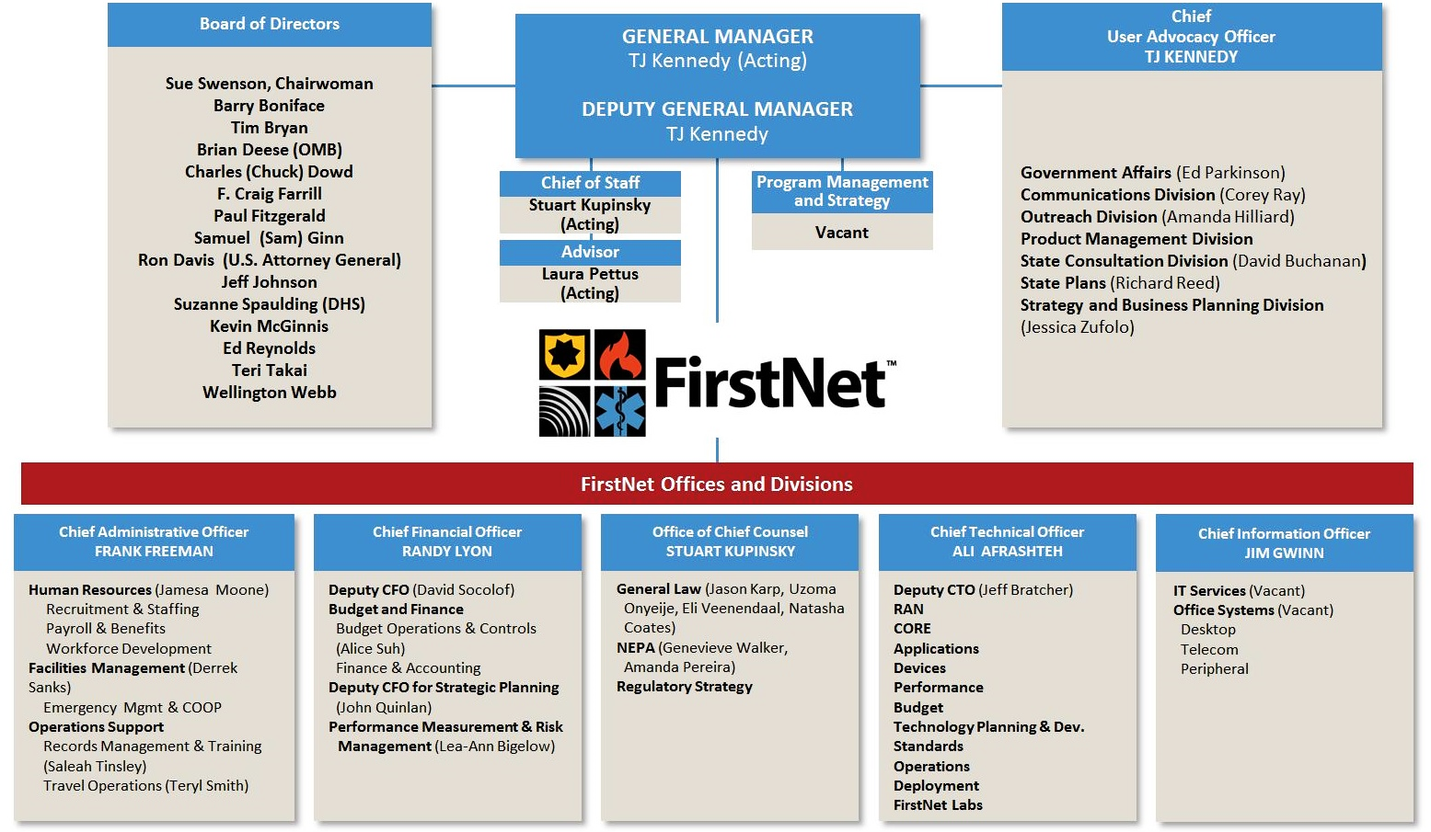




FirstNet Basics
ATTENDING JULY 29TH
FirstNet Organizational Chart
For more on governance, see: http://firstnet.gov/

Slide 6
FirstNet Basics
MD is working to be a national leader in FirstNet Outreach
1000+ Stakeholders reached
Hosted FEMA coverage workshop
3 regional technology forums
200+ attendees
Established a website, used as the national depository for FirstNet resources
1500+ page views since April
Twitter @MDInterOP
200+ followers
LinkedIn
National Timeline
Outreach
Data Collection
MD has completed its Initial Consultation Package for FirstNet
MD has created a state-of-the-art survey tool to collect Stakeholder data
We are Here
Network Design
Referred to as “Consultation”
Iterative Process
In MD – Begins July 29, 2014
Offer to Governor
Rollout
Operations
2014
2015
…

Slide 7
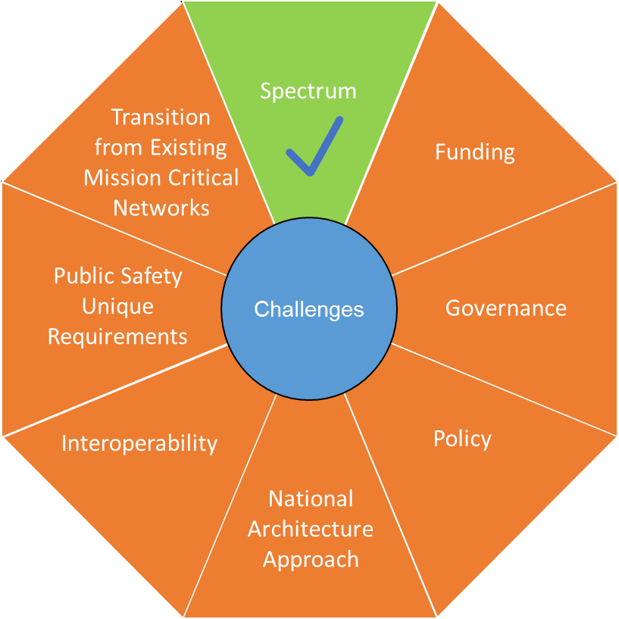

About Consultation
Challenges Facing FirstNet
Image courtesy of Department of Homeland Security, OEC. For more, see http://www.dhs.gov/about-office-emergency-communications
For more on the consultation process, see: https://mdinterop-public.sharepoint.com/process.

Slide 8
About Consultation
Meeting Attendees
FirstNet Attendees:
Along with FirstNet personnel above:
policy experts,
technical expertise
network engineers
Maryland Attendees
Office of the Governor
Maryland State Police
Maryland Emergency Management Agency
Maryland Institute for Emergency Medical Services Systems
Department of Natural Resources & Maritime Law Enforcement Information Network
Department of Information Technology
Department of Public Safety and Correctional Services
There will also be a group of local and regional representatives in attendance.

Slide 9
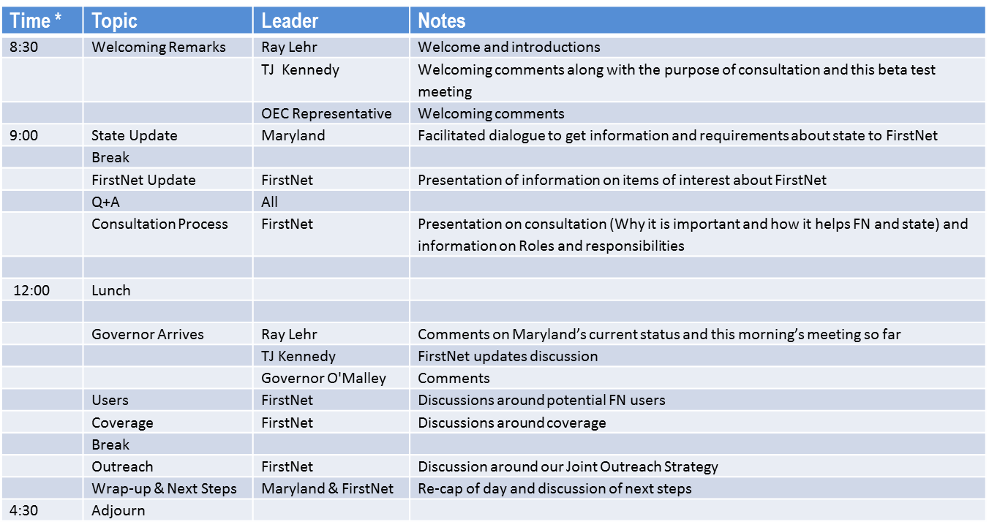
About Consultation
* Note that specific times are not listed as we want to allow for an open dialog as necessary

Slide 10
About Consultation
Goals
Receive project update
Start laying out requirements for Maryland’s RAN
Understand data to be collected to support RAN design
Understand project timelines, and milestones
Help FirstNet refine consultation for other states and territories

Slide 11

About Consultation
What to Bring to the July 29 meeting:
An open mind.
You do NOT need to bring anything else.

Slide 12
About Consultation
Come Ready to Discuss
1. What mission critical data services do you currently use and for what purpose?
Example: Use of personal commercial devices to view OSPREY, WebEOC, or CAD-RMS.
2. What are the key faults or limitations with regards to your current data usage?
Examples:
i. commercial network failure during high-volume events or severe weather events
ii. devices are not hardened for first responder use
iii. no interoperability.
3. What mission critical capabilities would you want from FirstNet?
Examples:
i. live video
ii. GIS mapping
iii. instant access to suspect profiles
4. What are your key questions/concerns regarding the implementation of FirstNet in Maryland?
Examples:
i. cost of building and maintaining the network
ii. cost of access to the network
iii. security concerns

Slide 13
About Consultation
Handling the Press and Public Outreach
This is not a public forum. Public Safety Sensitive information will be discussed candidly.
Direct all press inquiries to Ray Lehr
FirstNet, The Office of the Governor and the MDInterop team all have coordinated press efforts. Please use those channels if a need arises.
Please do not tweet or make other social media postings

Slide 14
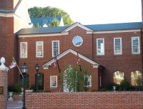
About Consultation
First Step for FirstNet?
Initial Consultation Meeting
Date: July 29th, 2014
When: 08:30
Place: Miller Senate Office Building West
11 Bladen Street
Annapolis, MD 21401

Slide 15
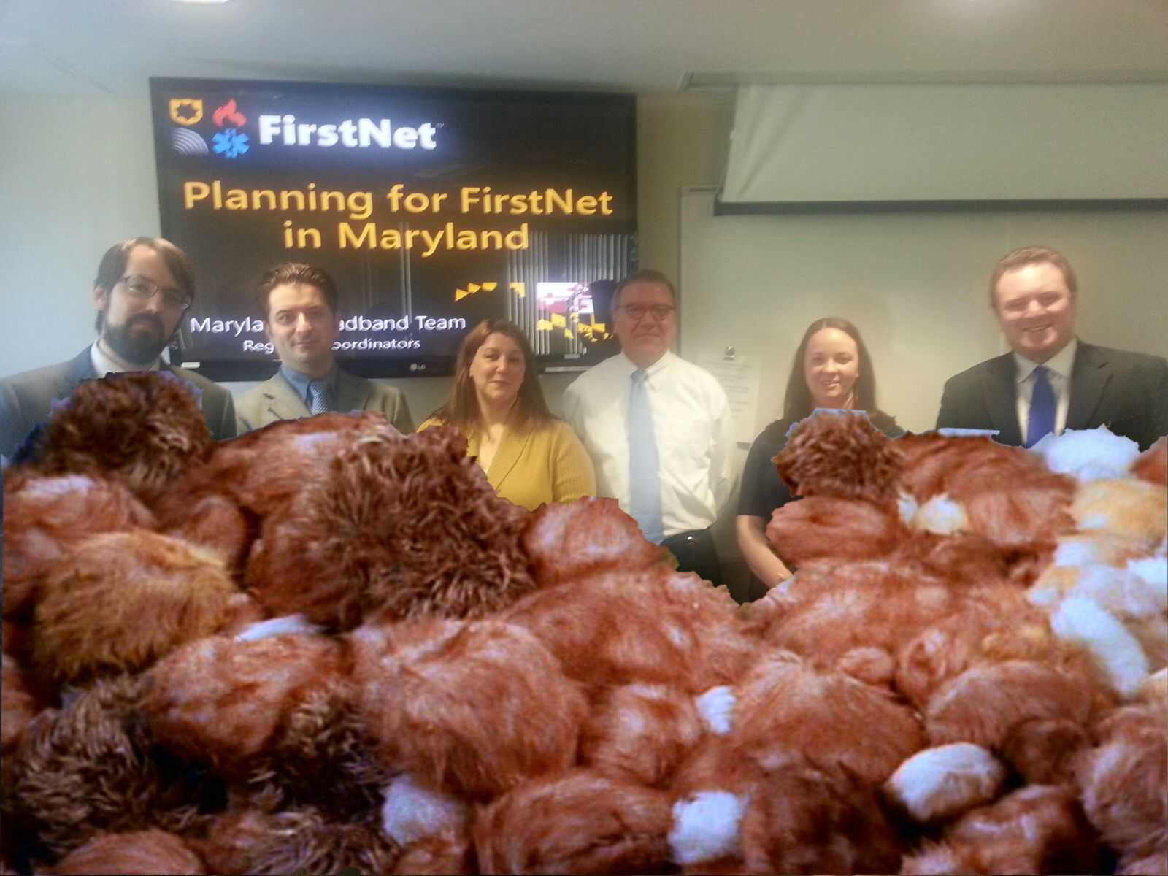
FirstNet Consultation Prep Pack
Prepared by Maryland Interoperability Team.
info@mdinterop.onmicrosoft.com
https://mdinterop-public.sharepoint.com/
Twitter: @MDInterOp

Slide 16
Disclaimer
This slide deck was prepared by the Maryland Department of Information Technology using funds under award 24-10-S13024 from the National Telecommunications and Information Administration (NTIA), U.S. Department of Commerce (DOC). The statements, findings, conclusions, and recommendations are those of the author(s) and do not necessarily reflect the views of the NTIA, DOC, or FirstNet.

